Slide 1
915 MHz Transceiver for Digital Communication
Team: Peter Handler, Philip Pierce, and Connor Dickey
Advisors: Dr. Aleksander Malinowski and Dr. Prasad Shastry
Department of Electrical and Computer Engineering, Bradley University
Notes:
Connor
Each team member introduce themselves.
Connor read title and project.
20 sec

Slide 2
Presentation Outline
Why this project exists
Device Specifications
System Modularity
Project Timeline
Additional Considerations
Conclusion
Notes:
Connor
Why did we choose this project?
Preliminary Specifications
Explain Ability to modify to specific use cases
Outline of the slides coming up, who’s talking

Slide 3
Why this project exists
Notes:
Connor
3 sec

Slide 4


Project overview
Lack of available 915MHz open-source and open-hardware modules
As an example use case and practical implementation of the 915MHz module
Enable extensible and easy communication tailored to more specific use cases
Low Cost and ubiquitous hardware to facilitate inexpensive modules.
Notes:
Connor
Our Implementation of the 915 MHz module can serve as an example use case for OS OH RF.
Our project is designed for custom implementation to be easily tailored for a specific use case.
Low Cost, easy to get in with hardware that already exists
We wanted our product to have
40 sec

Slide 5
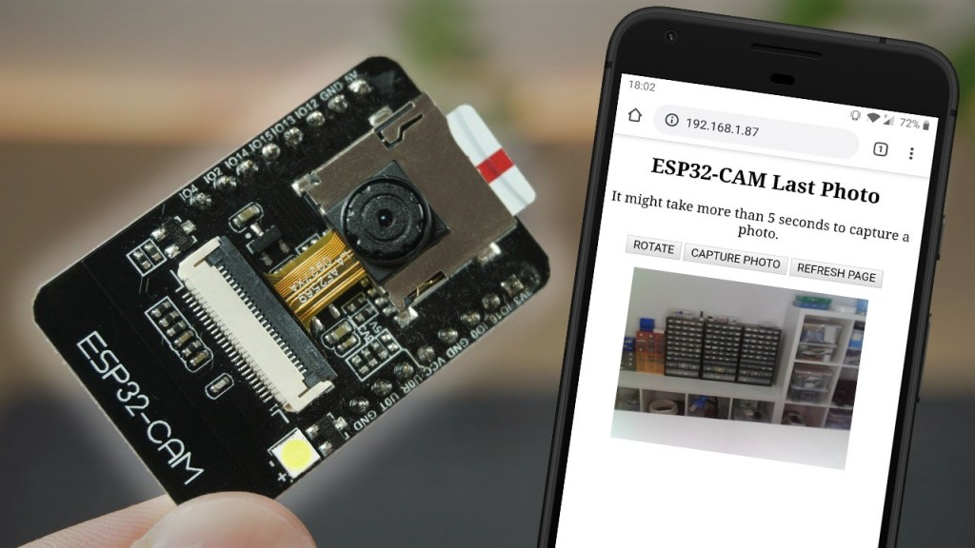
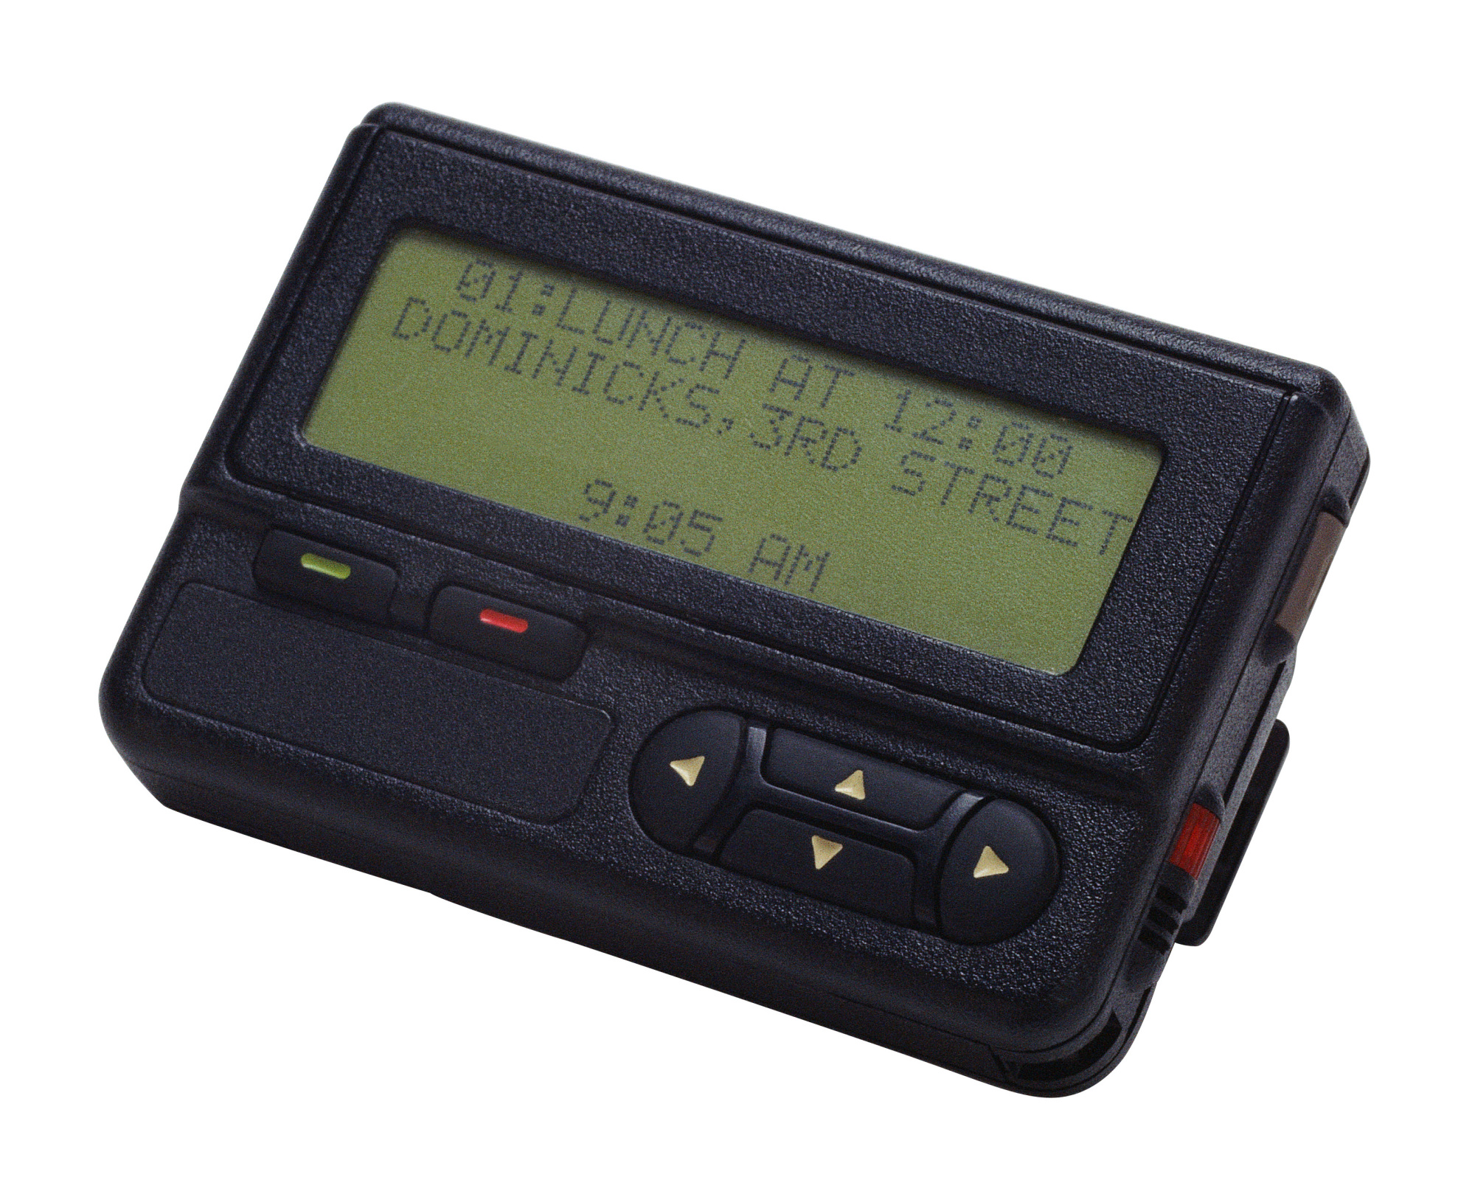
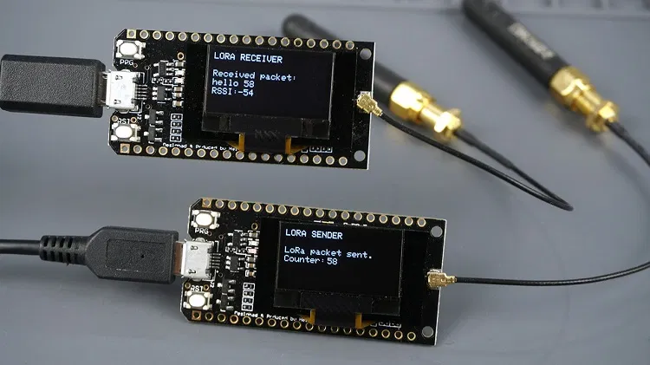
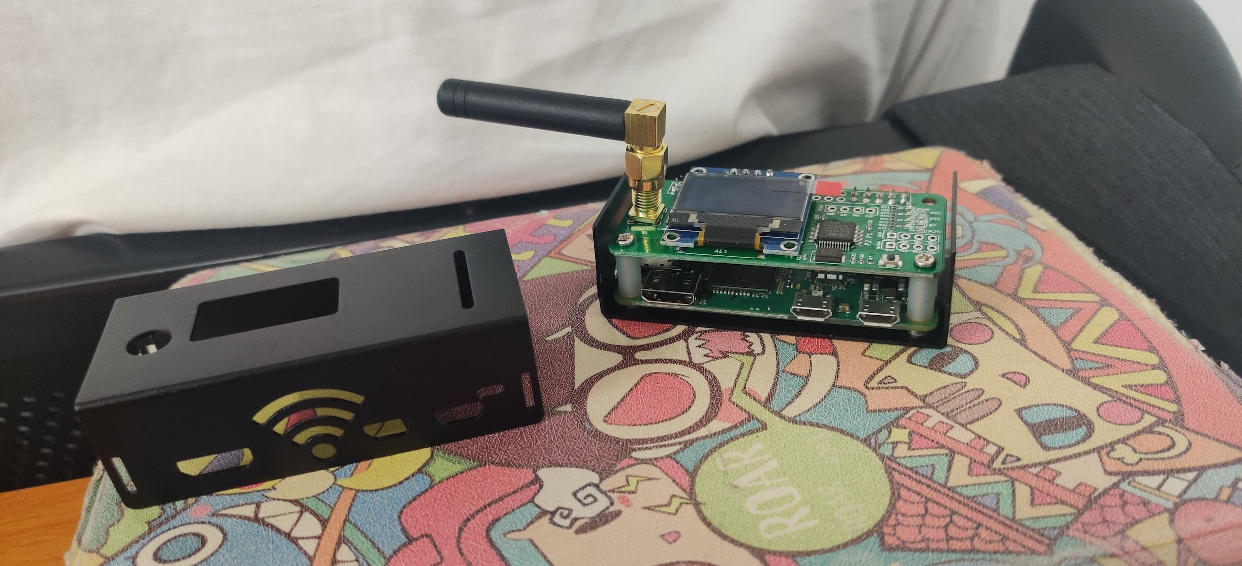
Potential Applications
Notes:
Peter
Segway to pictures/examples
Here are the applications that we picked
The project is to build a platform
For applications like a remote trail camera system or a modernized pager system.

Slide 6
Table of LoRa WAN vs our Product
 | LoRa | Our Product
Frequency | 902-928 MHz | 902-928 MHz
Data Rate | 300 bit/s - 27 kbit/s | 512 bit/s - 9.6 kbit/s
Duty Cycle | Very Low | Up to 100%
Hand-Shake | Required Handshake | Optional Handshake
Broadcasting | Does not Support | Support
License | $6000 Yearly | Free for use
Notes:
Peter
LoRa main competition
Table talk
LoRa is not intended for continuous transmission and is meant for low data cycle

Slide 7
Device Specifications
Notes:
Peter

Slide 8
Preliminary Specifications of Transceiver module
Transceiver | MAX 7037
Modulation | FSK ASK
Antenna | SMA male 50 Ω
Power Max | 10 dBm - 10mW
Frequencies | 915 ISM band (902-928 MHz)
Theoretical Range
2dbi Antenna ideal range is 2.9km (1.80 Miles)
5dbi Antenna ideal range is 15km (9.3 Miles)
Baseline Current draw at 3.3V
Sleep draw is .8mA
Full TX draw is 120mA
RX draw is 20mA
Notes:
Peter

Slide 9
Preliminary Specifications of Control module
Microcontroller | ESP 32
Communication I/O Protocols | SPI, I2C, WiFi, BT UART
Power Supply | 12V → 5V → 3.3V
Supported Modules | Camera, Display, GPS, Battery, and Environment Sensor
Baseline Current draw 3.3V
Sleep draw is .8mA
RF Tx off draw is 40mA
RF Tx on draw is 160mA
RF Tx off, Wifi/BT on draw 240mA
External power budget 12V
1A peak draw to peripheral devices
Notes:
Philip
The baseline wifi / bt off. Power draw will certainly be higher in the real world
So heres the testing….

Slide 10
Function testing Quantitative Testing
Component level testing
Software stability
Proper hardware installation
Digital Radio
Successful Tx/Rx modulation
Compliance with regulations
Module Testing
Operates as intended
Communication between systems
Max Range Testing for 2dbi Antenna
Max Range Testing for 5dbi Antenna
Power Draw on Maximum RF Tx Power
Power Draw on Minimum RF Tx Power
Power Draw for different RF Protocols
Notes:
Peter
Talk about how are you going to test, what is expected

Slide 11
B.O.M.
QTY | Vendor | Vendor Part | ITEM DESCRIPTION | UNIT PRICE | TOTAL
1 | Digikey | MAX7037EVKIT915#-ND | Eval Board Max7037 | $254.99 | $254.99
10 | Digikey | MAX7037EGL+-ND | MAX7037 Chips | $5.96 | $59.62
2 | Digikey | 343-ANT-916-CW-RCL-SMA-ND | SMA 900Mhz Hi Gain (Small) Antenna | $8.68 | $17.36
2 | Digikey | 2151-RST-W1B6-10808-22M-FY-001-ND | SMA 900Mhz Low Gain (Small) Antenna | $4.64 | $9.28
2 | Digikey | 1597-104020250-ND | OLED Display 1.12 (SH1107) v3.0 128x128 resolution | $12.50 | $25.00
1 | Digikey | 1597-103020272-ND | I2C HUB (6 PORT) | $1.70 | $1.70
1 | Digikey | 1597-1092-ND | 4PIN MALE JUMPERS 5PACK | $3.20 | $3.20
1 | Digikey | 1597-109020022-ND | GPS module for GPS / Beidou / Glonass / Galileo / QZSS / SBAS | $13.10 | $13.10
2 | Digikey | 1597-1674-ND | Switch Human Interface 5WAY | $4.90 | $9.80
2 | Digikey | 1597-104020169-ND | RGB LED | $4.40 | $8.80
2 | Digikey | 1597-111020103-ND | Switch Human Interface Large Dual Button | $2.40 | $4.80
1 | Digikey | 223-1785-ND | MS8607 SENSOR FOR GROVE SYSTEM | $16.09 | $16.09
2 | Digikey | 1597-1687-ND | ESP32-CAM 2MP WIFI+BT AI-THINKER | $10.00 | $20.00
2 | Digikey | 1965-ESP32-DEVKITC-32E-ND | ESP32-WROOM-32E series Transceiver Evaluation Board | $10.00 | $20.00
1 | Amazon | SMA Female Base | SMA Female Jack Connector 10-Count | $7.89 | $7.89
1 | Amazon | B07BBPX8B8 | UART Cable | $10.99 | $10.99
SUBTOTAL | $482.62
SHIPPING | $12.00
TOTAL | $494.62
Notes:
Philip
Bill of materials, the parts we will be using to develop our prototype and get started with the design, programming, testing under our starting budget

Slide 12
System Modularity
Notes:
Philip

Slide 13
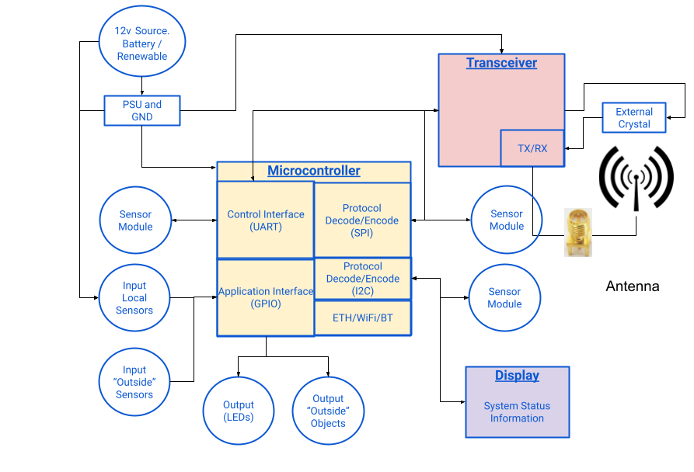
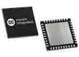
Block Diagram
Notes:
Philip
The Block Diagram
“So this is how all those parts in the list will go together”
The Block Diagram details the connection between different parts and modules of the Transceiver.

Slide 14
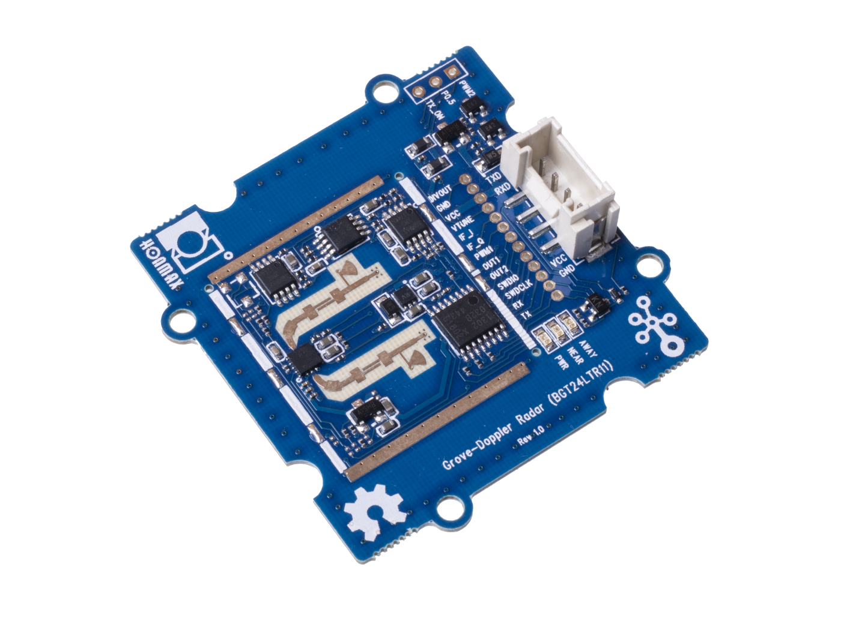
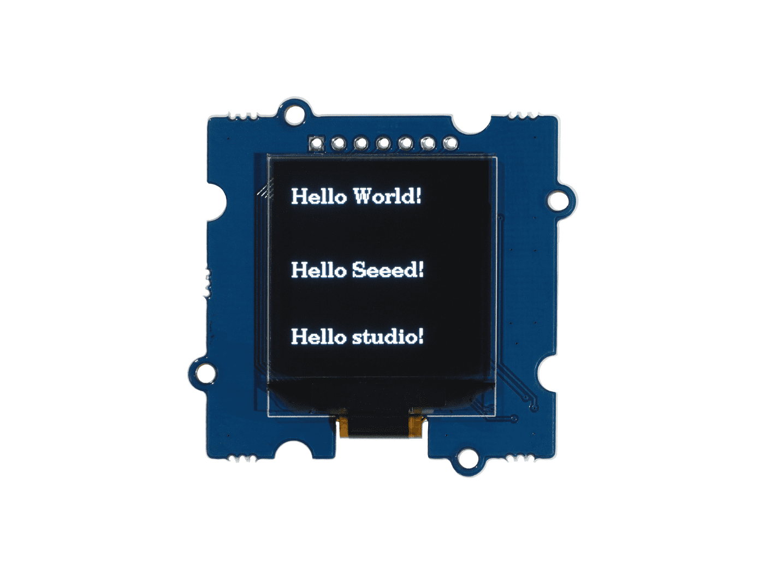
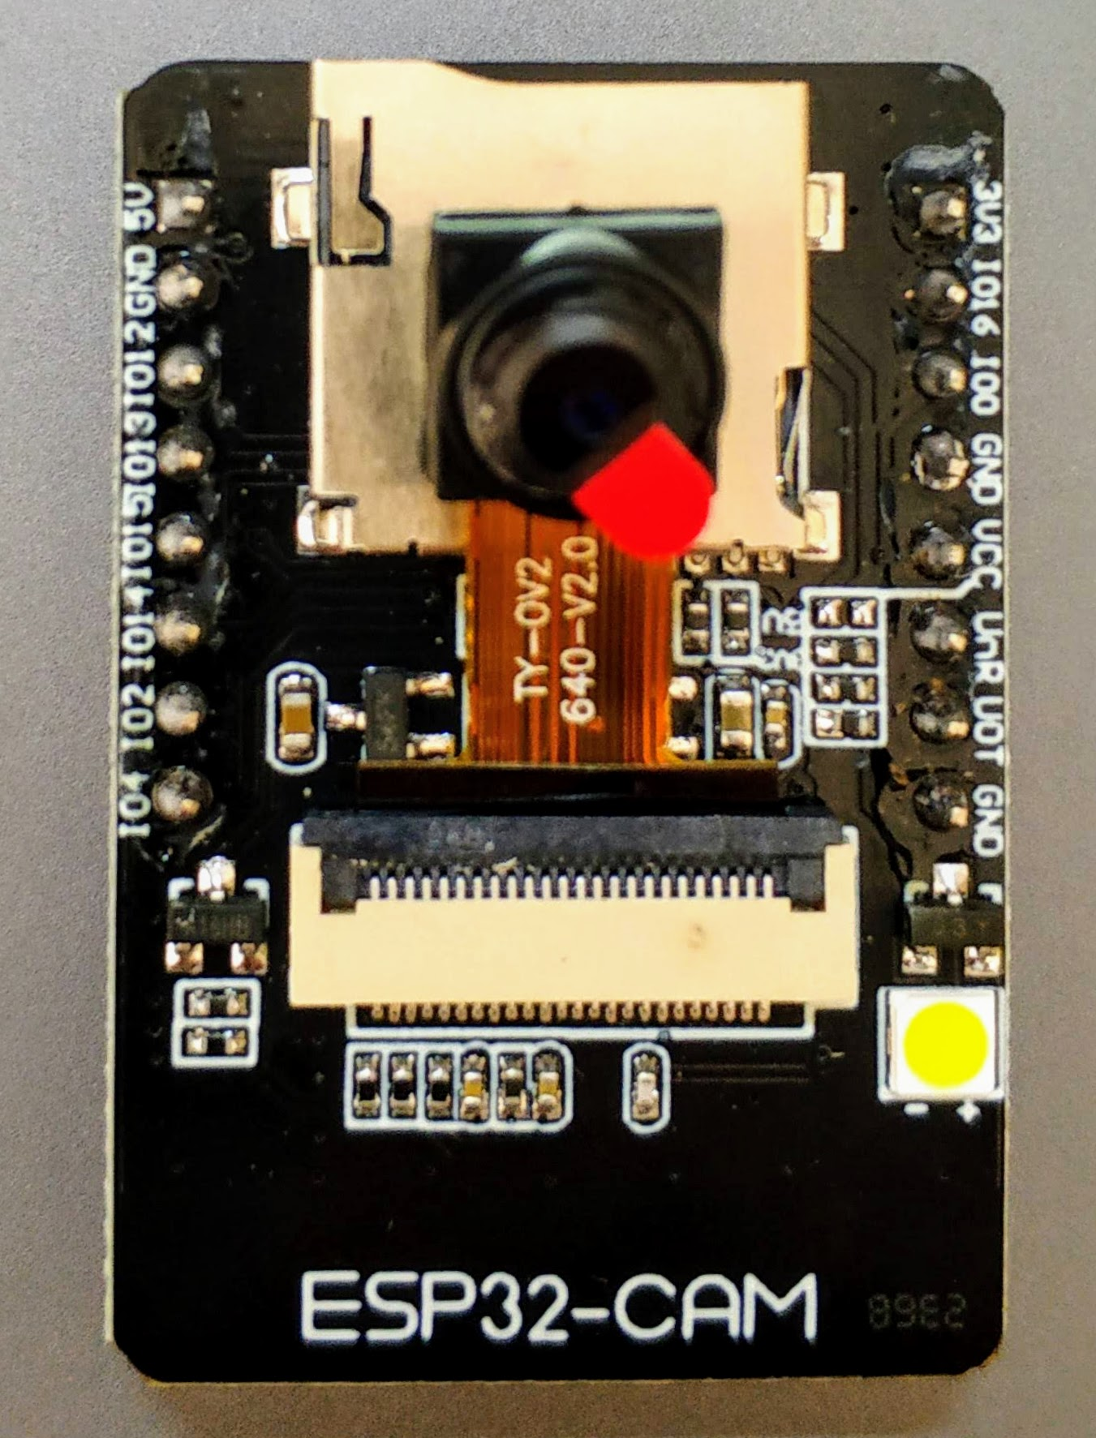
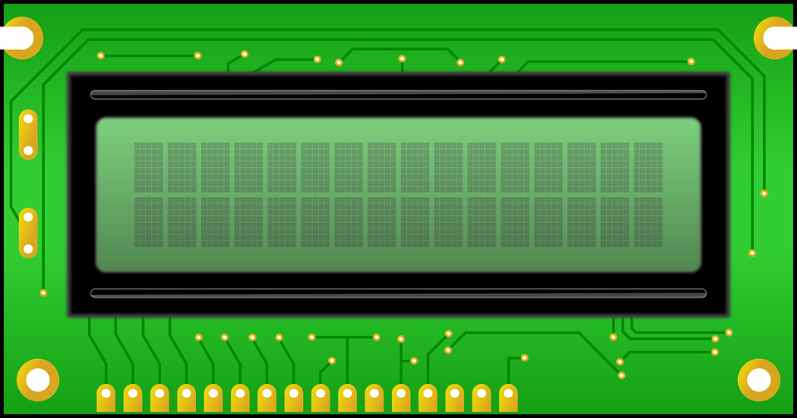
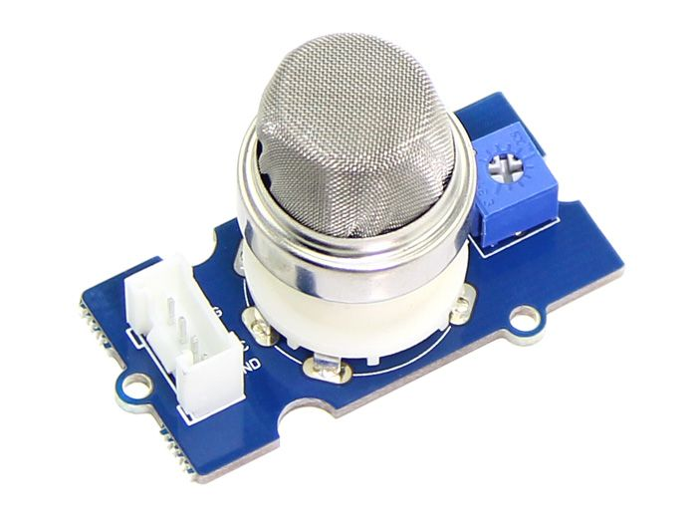
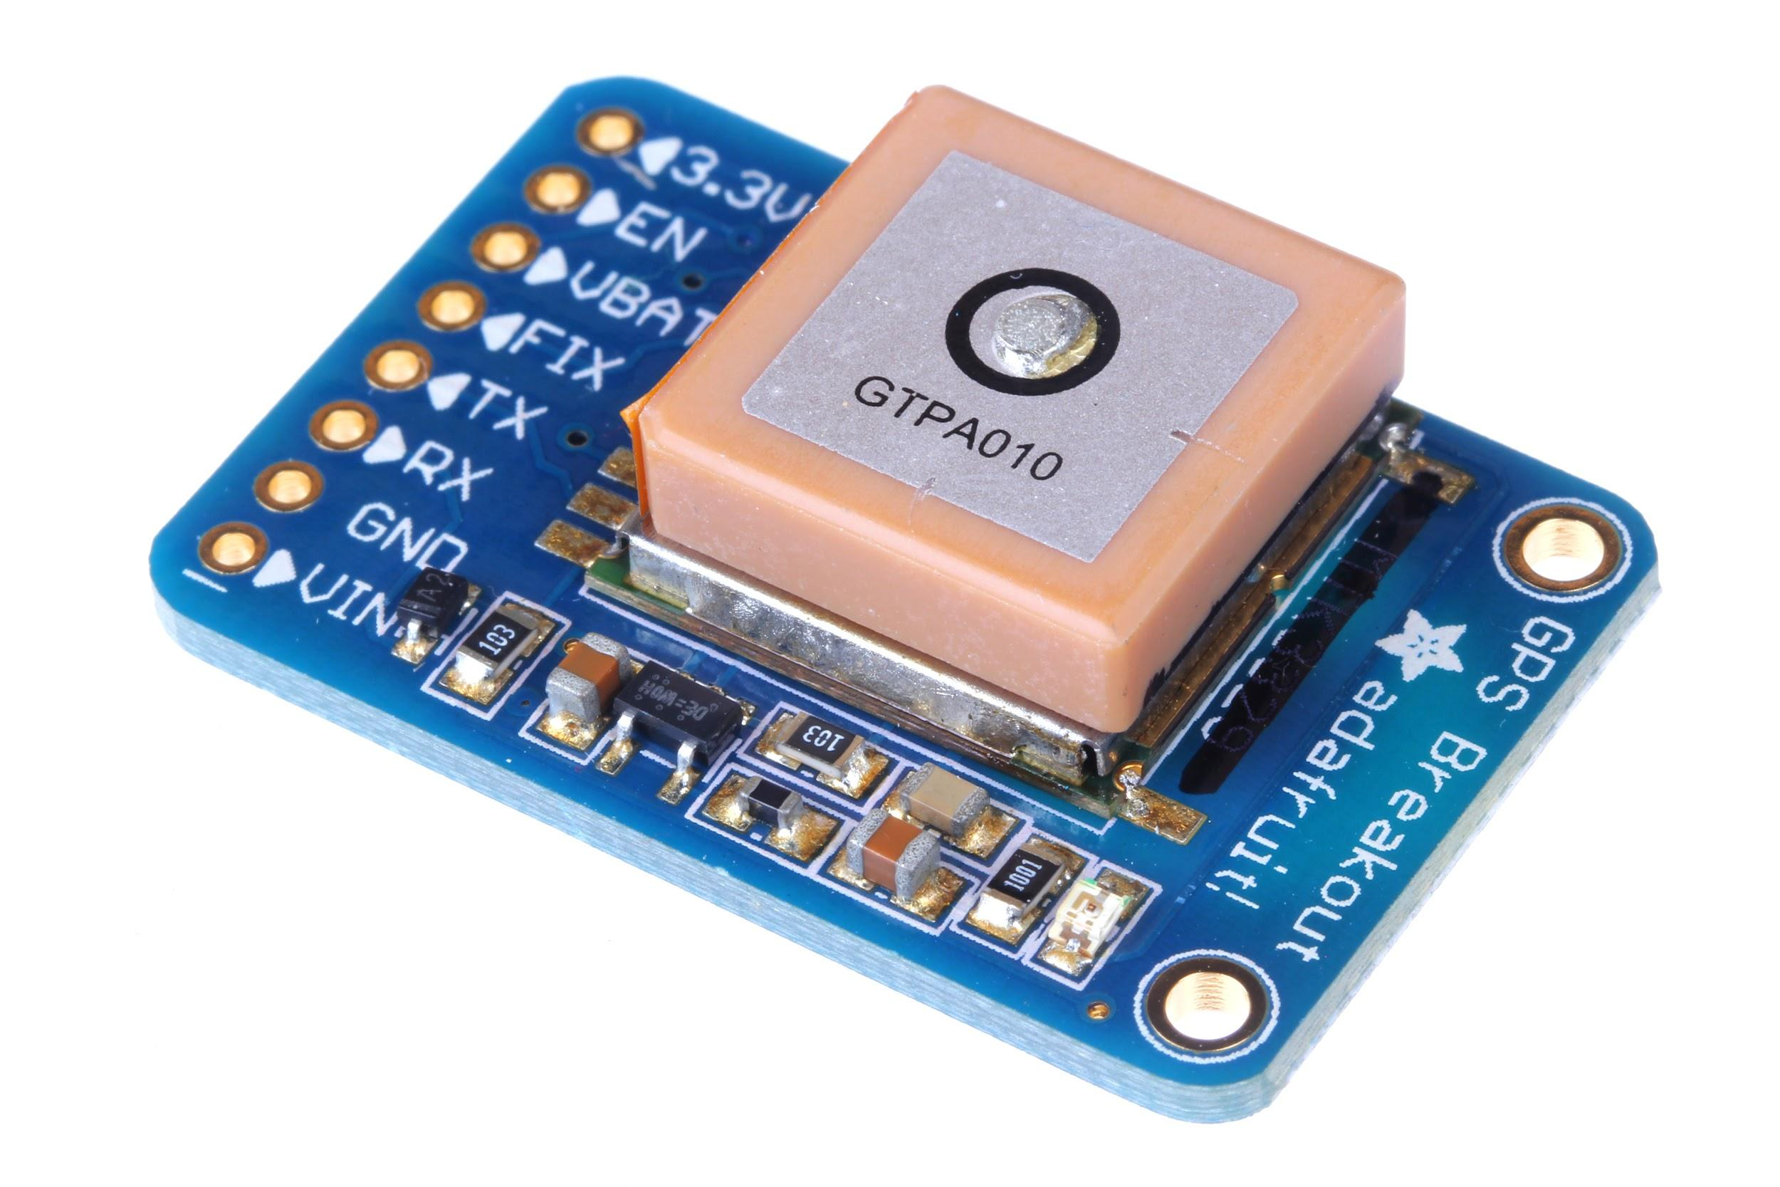
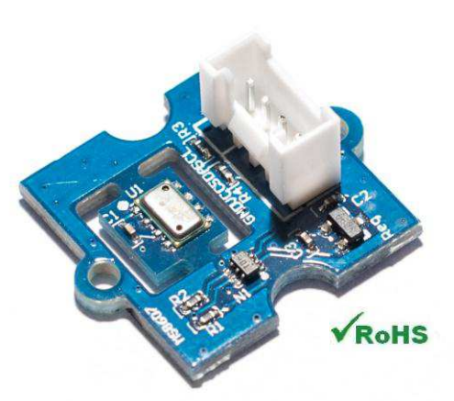
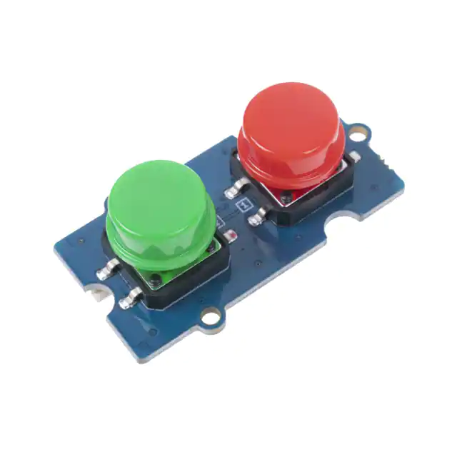
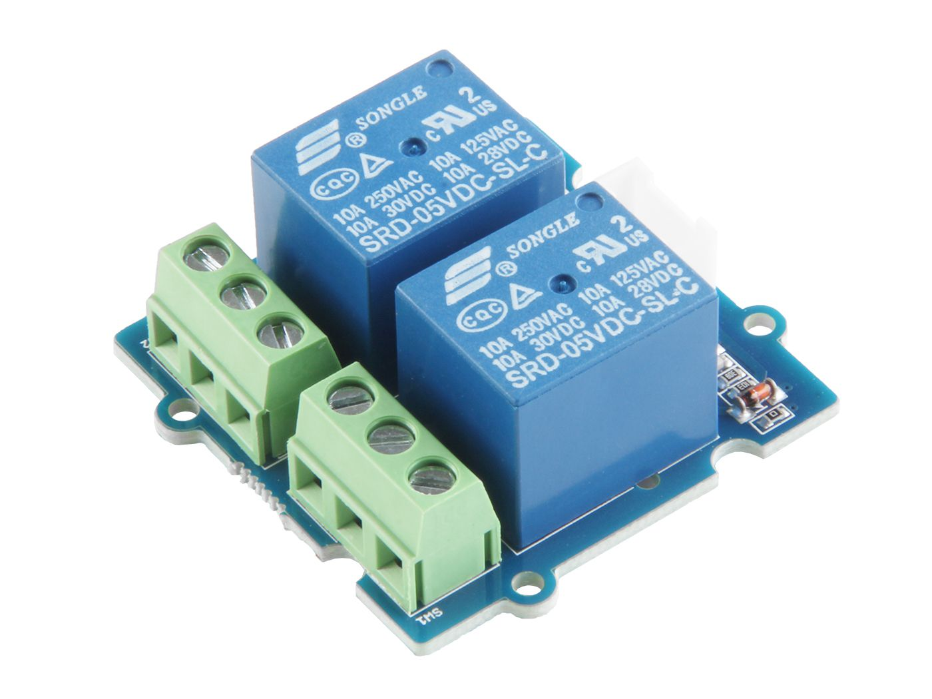
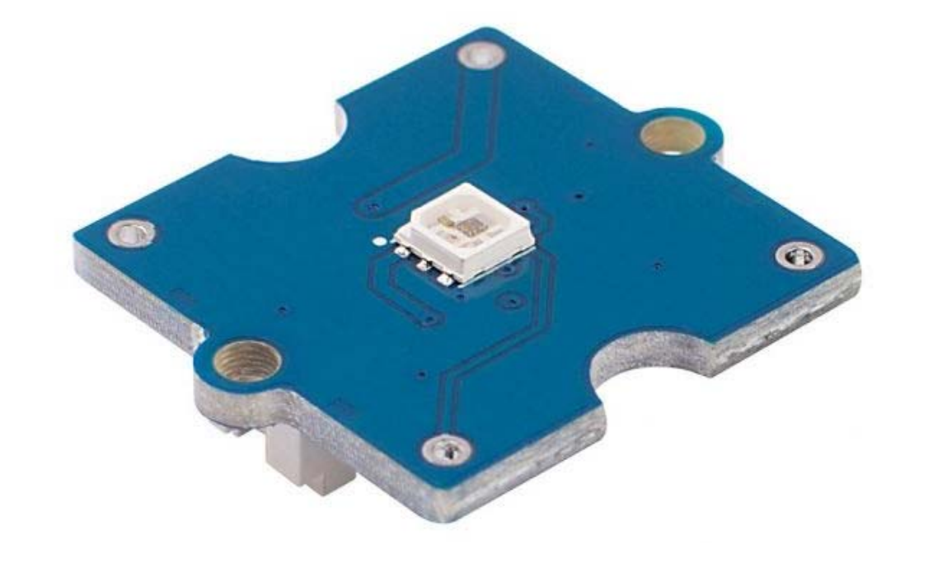
Potential Modular Accessory
Notes:
Philip
Using various Communication I/O Protocols, there is the potential for many kinds of modules that can extend the usability of the basic transceiver.
As a reminder, we are planning to roll out with Camera, Display, GPS, Battery, and Environment Sensor support.
That won’t stop the ability to continue development with other more advanced sensors or interfaces like Dopllar Radar or Relays.

Slide 15
Project Timeline
Notes:
Philip

Slide 16
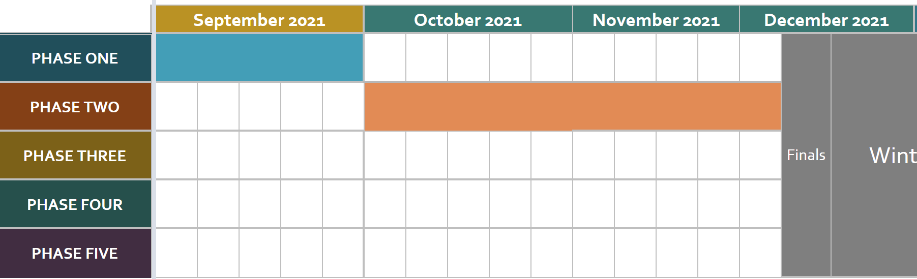
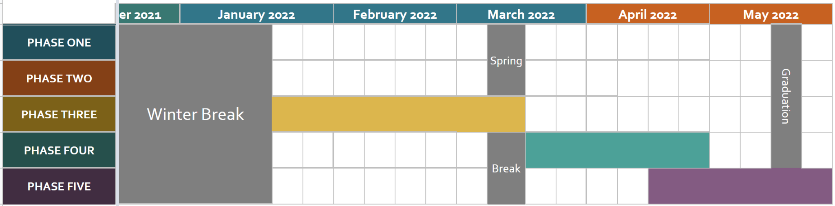
High Level Timeline Overview
Notes:
Philip
This slide has two clicks for animation
Project Conception
Planning and Presentation
Starting the Project and Prototype
Refine the Project and Assembly
Finish and Document

Slide 17
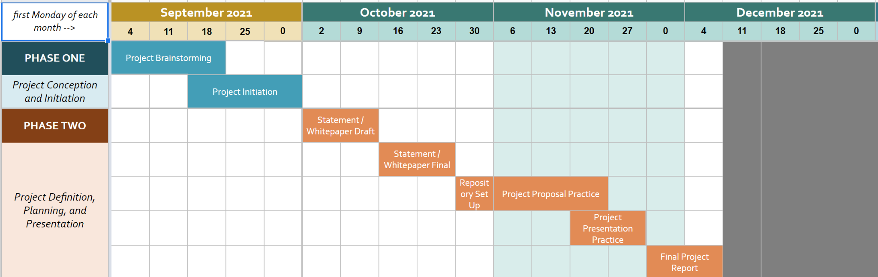
Senior Project Progress
Notes:
Philip

Slide 18
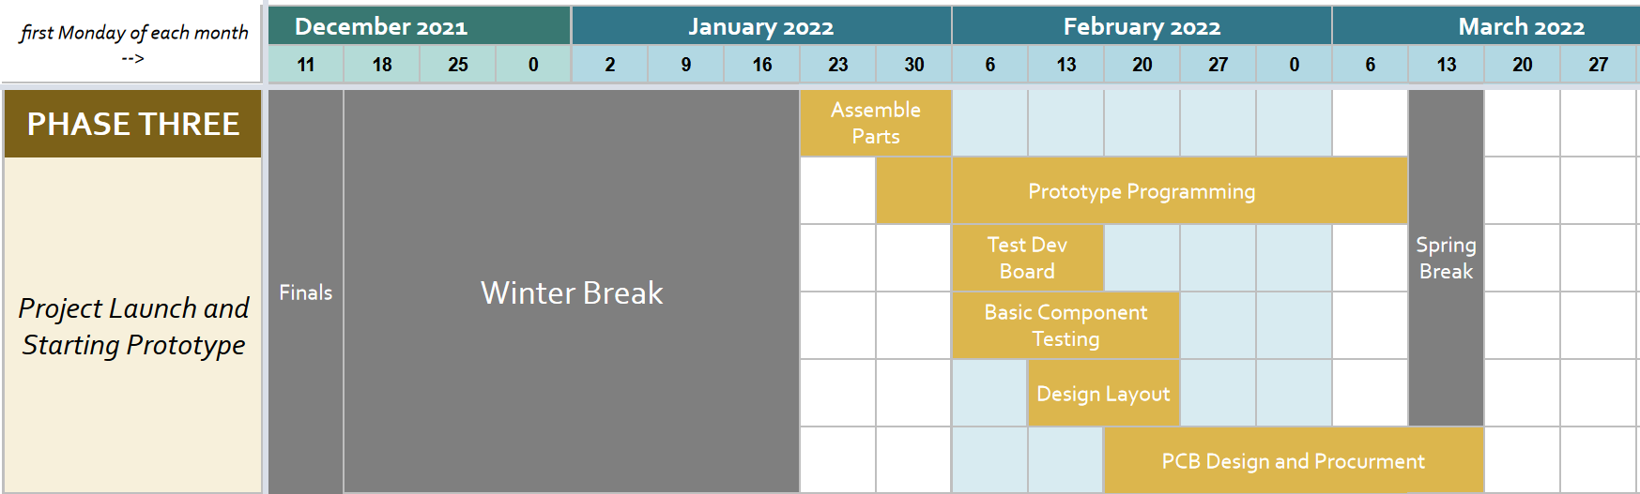
Notes:
Philip

Slide 19
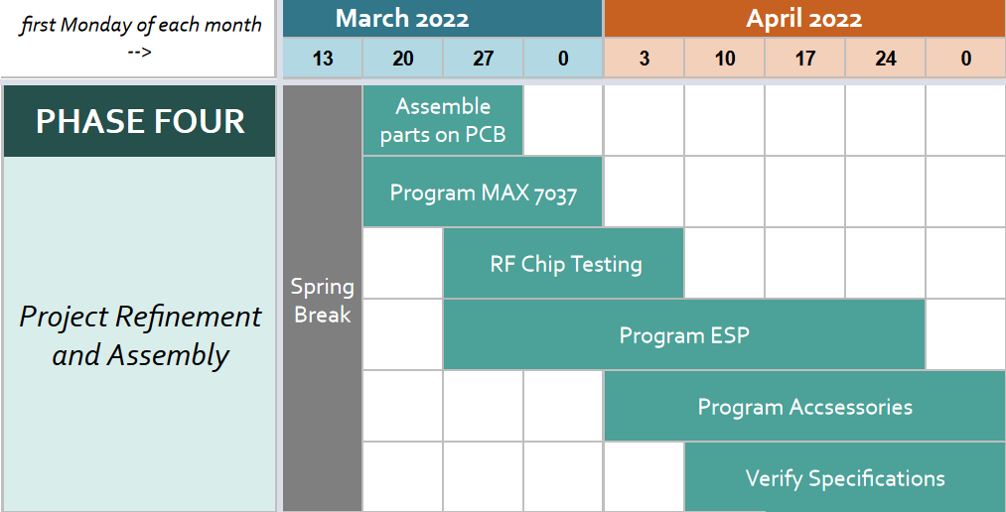
Notes:
Philip

Slide 20
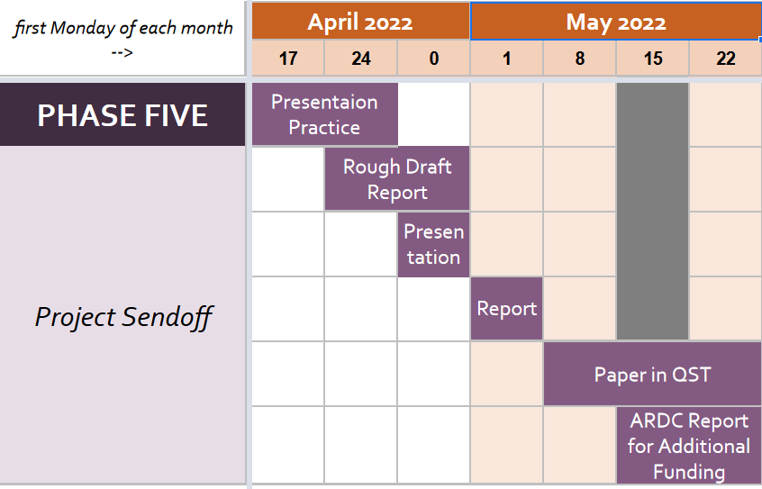
Notes:
Connor
The final stage of our project is to finish and document our findings.
We will consolidate our documentation with these findings to create our final presentation and report.
20 sec

Slide 21
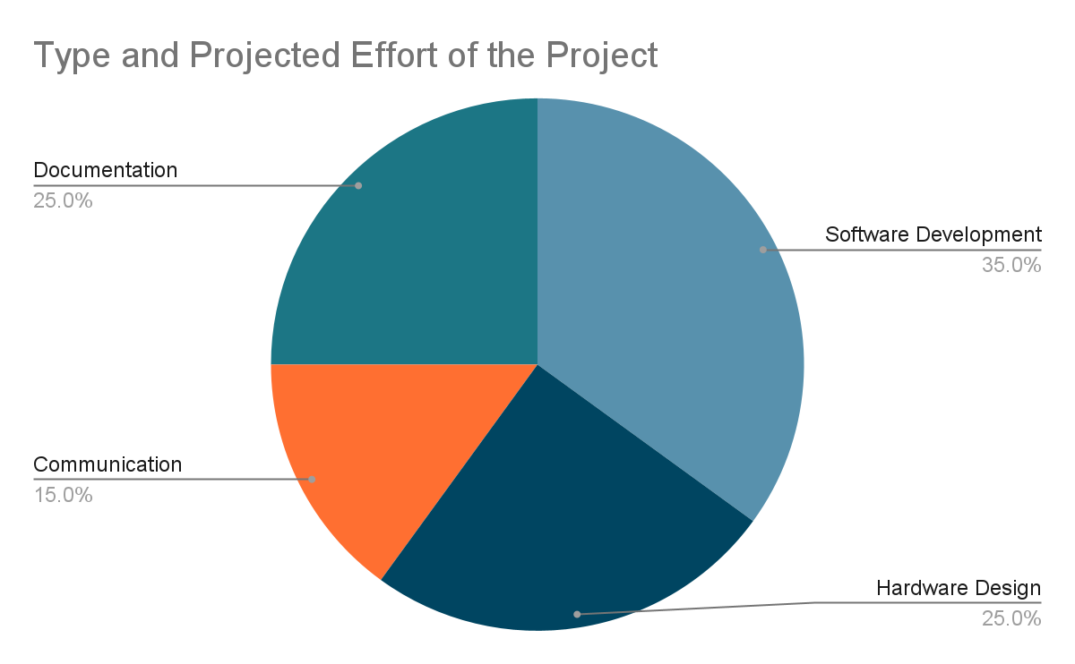
Division of Work
Software Development
Hardware Design
Communication Schemes
Documentation
All have general knowledge in topics
Notes:
Connor
As our tasks shown in the timeline listed previously, the tasks next semester are grouped into 4 different topics
It allows for great team awareness of the overall project.
Team division
Documentation
All, for what we work on
Communication
Connor
Software Development
Philip
Hardware Design
Peter

Slide 22

Parts
Three rounds of funding
ECE Department
ARDC R&D
ARDC Production
Notes:
Peter

Slide 23
Additional Considerations

Slide 24

Software and Tools
PCB Designer / CAD
-Keysight PathWave ADS
-KiCAD
Embedded Systems Development
VS Code + ESP-IDF ESP32
Github
RF Lab
Network Analyzer
Spectrum Analyzer
Oscilloscope
Logic Analyzer
Notes:
Peter

Slide 25




Project Future
Endless Applications
Driven by Community Engagement
Additional Communication Protocols
Notes:
Connor
Open Source allows for Endless Applications.
The Majority of our advances will be driven by community engagement.

Slide 26
Conclusion
Notes:
Philip

Slide 27
In Summary
Microcontroller powered RF transceiver board for digital radio modes in the 915 MHz ISM band.
Will be entirely Open source and Open hardware to make a positive impact in open initiatives and receive contributions from others.
Use a higher duty cycle and be designed with extensibility in mind compared to the popular and proprietary alternative LoRa.
Use ubiquitous and inexpensive hardware to build the board and interface with a variety of external modules.
Notes:
Philip
Enable tailoring to more specific use cases, like one way pager

Slide 28
Any Questions?

Slide 29
References
https://www.espressif.com/sites/default/files/documentation/esp32_datasheet_en.pdf
https://datasheets.maximintegrated.com/en/ds/MAX7037.pdf
https://lora-alliance.org/resource_hub/lorawan-104-specification-package/

